Slide 1
Solving Permutation Problems with Estimation of Distribution Algorithms and Extensions Thereof
Josu Ceberio

Slide 2
Outline
Permutation optimization problems
Part I : Contributions to the design of Estimation of Distribution Algorithms for permutation problems
Part II: Studying the linear ordering problem
Part III: A general multi-objectivization scheme based on the elementary landscape decomposition
Conclusions and future work

Slide 3
Permutation optimization problems Definition
Combinatorial optimization problems

Slide 4
Permutation optimization problems Definition
Problems whose solutions are naturally represented
as permutations

Slide 5
Permutation optimization problems Notation
A permutation is a bijection of the set
onto itself,

Slide 6
Permutation optimization problems Goal
To find the permutation solution that minimizes
a fitness function
The search space consists of solutions.

Slide 7
Permutation optimization problems
Travelling salesman problem (TSP)
Permutation Flowshop Scheduling Problem (PFSP)
Linear Ordering Problem (LOP)
Quadratic Assignment Problem (QAP)

Slide 8
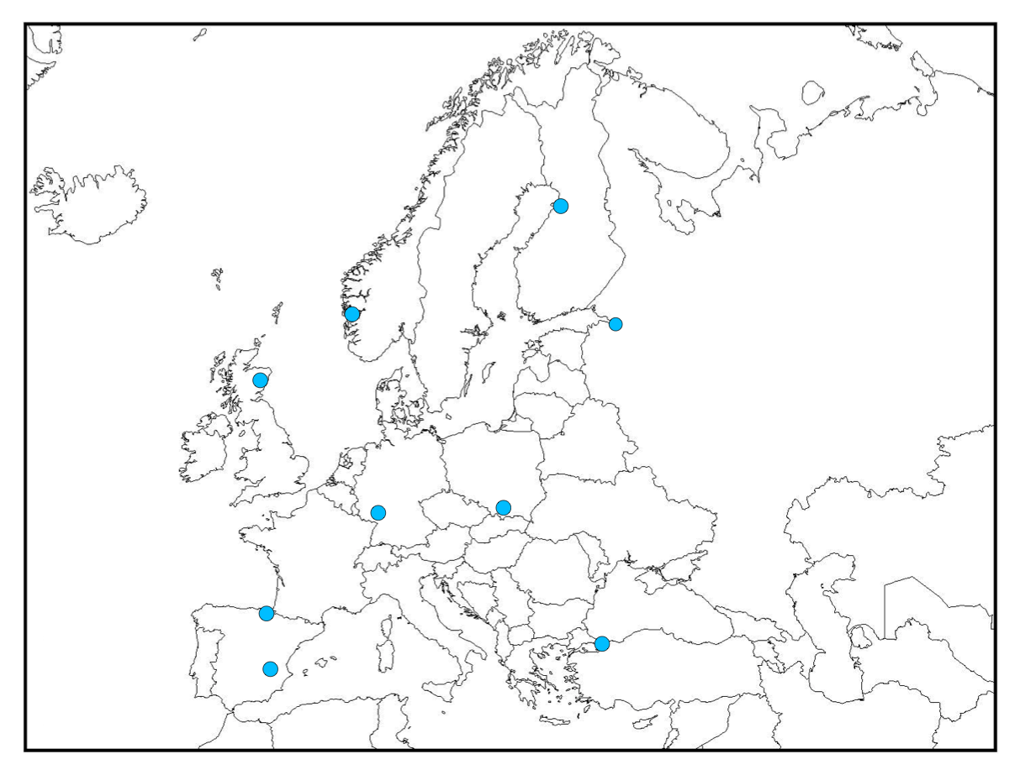
Permutation optimization problems Travelling Salesman Problem (TSP)
9
Which permutation
of cities provides
the shortest path?
8
7
6
5
3
2
4
1

Slide 9
Permutation optimization problems Travelling Salesman Problem (TSP)
9
Which permutation
of cities provides
the shortest path?
8
7
6
5
3
2
4
1

Slide 10
Permutation optimization problems Travelling Salesman Problem (TSP)
9
Possible routes:
8
7
6
5
3
2
4
1

Slide 11
Permutation optimization problems Definition
Many of these problems are NP-hard.
(Garey and Johnson 1979)

Slide 12
Contributions to the design of EDAs for permutation problems
Part I

Slide 13
Estimation of distribution algorithms Definition

Slide 14
Review of EDAs for permutation problems EDAs for integer domain problems
The sampling step may not provide permutations, but solutions in .
Learn a probability distribution over the set

Slide 15
Review of EDAs for permutation problems EDAs for integer domain problems
The sampling step may not provide permutations, but solutions in .
The probabilistic logic sampling is modified to guarantee mutual exclusivity constraints.
Learn a probability distribution over the set

Slide 16
Review of EDAs for permutation problems EDAs for integer domain problems
The sampling step may not provide permutations, but solutions in .
The probabilistic logic sampling is modified to guarantee mutual exclusivity constraints.
EDAs that have used this approach:
UMDA
MIMIC
EBNA
TREE
…
Learn a probability distribution over the set

Slide 17
Review of EDAs for permutation problems EDAs for continuous domain problems
The probability of a given permutation cannot be calculated in closed form.
Sample solutions of real values
(0.30, 0.10, 0.40, 0.20) (0.27, 0.62, 0.71, 0.20)
3 1 4 2 2 3 4 1
Learn a probability distribution on the continuous domain

Slide 18
Review of EDAs for permutation problems EDAs for continuous domain problems
Highly redundant codification
Learn a probability distribution on the continuous domain
(0.30, 0.10, 0.40, 0.20)
(0.25, 0.14, 0.35, 0.16)
(0.60, 0.20, 0.80, 0.40)
(0.27, 0.15, 0.31, 0.20)
(0.83, 0.01, 0.99, 0.70)
(0.37, 0.07, 0.75, 0.36)
(0.60, 0.50, 0.71, 0.52)
(0.17, 0.05, 0.21, 0.10)
3 1 4 2
EDAs that have used this approach: UMDA_{c}, MIMIC_{c}, EGNA…

Slide 19
Review of EDAs for permutation problems Permutation-oriented EDAs
Node and Edge Histogram-based Sampling Algorithms (EHBSA & NHBSA)
(Tsutsui et al. 2002, Tsutsui et al. 2006)
Node Histogram
Population
 |  | Position
 |  | 1 | 2 | 3 | 4 | 5
Item | 1 | 0.2 | 0.1 | 0.2 | 0.1 | 0.4
 | 2 | 0.4 | 0.3 | 0 | 0.2 | 0.1
 | 3 | 0.1 | 0.3 | 0.3 | 0.1 | 0.2
 | 4 | 0.1 | 0.2 | 0.4 | 0.1 | 0.2
 | 5 | 0.2 | 0.1 | 0.1 | 0.5 | 0.1
54123
42351
12354
24351
31452
23415
23451
25431
12543
53124

Slide 20
Review of EDAs for permutation problems Permutation-oriented EDAs
Node and Edge Histogram-based Sampling Algorithms (EHBSA & NHBSA)
(Tsutsui et al. 2002, Tsutsui et al. 2006)
Edge Histogram
Population
 |  | Item j
 |  | 1 | 2 | 3 | 4 | 5
Item i | 1 | - | 0.4 | 0.3 | 0.3 | 0.4
 | 2 | 0.4 | - | 0.5 | 0.3 | 0.3
 | 3 | 0.3 | 0.5 | - | 0.5 | 0.4
 | 4 | 0.3 | 0.3 | 0.5 | - | 0.6
 | 5 | 0.4 | 0.3 | 0.4 | 0.6 | -
54123
42351
12354
24351
31452
23415
23451
25431
12543
53124

Slide 21
Review of EDAs for permutation problems Permutation-oriented EDAs
Node and Edge Histogram-based Sampling Algorithms (EHBSA & NHBSA)
(Tsutsui et al. 2002, Tsutsui et al. 2006)
Template Strategy (WT)
Parent
4 | 2 | 5 | 3 | 8 | 1 | 9 | 6 | 7
Offspring

Slide 22
Review of EDAs for permutation problems Permutation-oriented EDAs
Node and Edge Histogram-based Sampling Algorithms (EHBSA & NHBSA)
(Tsutsui et al. 2002, Tsutsui et al. 2006)
Template Strategy (WT)
Parent
4 | 2 | 5 | 3 | 8 | 1 | 9 | 6 | 7
Offspring
4 | 2 | 5
8 | 1 | 3
9 | 6 | 7
Sample from the model

Slide 23
Review of EDAs for permutation problems Permutation-oriented EDAs
IDEA- Induced Chromosome Elements Exchanger (ICE)
(Bosman and Thierens 2001)
A continuous domain EDA hybridized with a crossover operator
Recursive EDA (REDA) (Romero and Larrañaga 2009)
A k stages algorithm, where at each stage, a specific part of the individual is optimized with an EDA
UMDA, MIMIC,….

Slide 24
Review of EDAs for permutation problems Experimental design
EDAs:
UMDA, MIMIC, EBNA_{BIC}, TREE
UMDA_{c}, MIMIC_{c}, EGNA
NHBSA_{WT}, NHBSA_{WO}, EHBSA_{WT},EHBSA_{WO}, IDEA-ICE, REDA_{UMDA}, REDA_{MIMIC}
OmeGA.
4 problems and 100 instances (25 instances of each problem).
Average of 20 repetitions of each algorithm.
Statistical test: Friedman + Shaffer’s static procedure.

Slide 25
Review of EDAs for permutation problems Experiments
Critical difference diagram
TSP
Best performing algorithms: NHBSA_{WT}, EHBSA_{WT}.

Slide 26
Review of EDAs for permutation problems Experiments
Critical difference diagram
TSP
Estimate first and second order marginal probabilities.

Slide 27
Three research paths to investigate
Learn models based on high order marginal probabilities
K-order marginals-based EDA
Implement probability models for permutation domains
The Mallows EDA
The Generalized Mallows EDA
The Plackett-Luce EDA
Non-parametric models
Kernels of Mallows models.

Slide 28
The Mallows model Definition
A distance-based exponential probability model
Central permutation
Spread parameter
A distance on permutations

Slide 29
The Mallows model Definition
A distance-based exponential probability model
Central permutation
Spread parameter
A distance on permutations

Slide 30
The Mallows model Definition
A distance-based exponential probability model
Central permutation
Spread parameter
A distance on permutations

Slide 31
The Generalized Mallows model Definition
If the distance can be decomposed as sum of terms
then, the Mallows model can be generalized as
n-1 spread parameters
The Generalized Mallows model

Slide 32
The Generalized Mallows model Kendall’s-τ distance
Kendall’s-τ distance: calculates the number of pairwise disagreements.
1-2
1-3
1-4
1-5
2-3
2-4
2-5
3-4
3-5
4-5

Slide 33
The Generalized Mallows model Learning and sampling
Learning in 2 steps:
Calculate the central permutation by means of Borda.
Population
5 4 1 2 3
4 2 3 5 1
1 2 3 5 4
2 4 3 5 1
3 1 4 5 2
2 3 4 1 5
2 3 4 5 1
2 5 4 3 1
1 2 5 4 3
5 3 1 2 4
Average solution
( , , , , )

Slide 34
The Generalized Mallows model Learning and sampling
Learning in 2 steps:
Calculate the central permutation by means of Borda.
Population
5 4 1 2 3
4 2 3 5 1
1 2 3 5 4
2 4 3 5 1
3 1 4 5 2
2 3 4 1 5
2 3 4 5 1
2 5 4 3 1
1 2 5 4 3
5 3 1 2 4
Average solution
( 2.7, , , , )

Slide 35
The Generalized Mallows model Learning and sampling
Learning in 2 steps:
Calculate the central permutation by means of Borda.
Population
5 4 1 2 3
4 2 3 5 1
1 2 3 5 4
2 4 3 5 1
3 1 4 5 2
2 3 4 1 5
2 3 4 5 1
2 5 4 3 1
1 2 5 4 3
5 3 1 2 4
Average solution
( 2.7, 2.9, , , )

Slide 36
The Generalized Mallows model Learning and sampling
Learning in 2 steps:
Calculate the central permutation by means of Borda.
Population
5 4 1 2 3
4 2 3 5 1
1 2 3 5 4
2 4 3 5 1
3 1 4 5 2
2 3 4 1 5
2 3 4 5 1
2 5 4 3 1
1 2 5 4 3
5 3 1 2 4
Average solution
( 2.7, 2.9, 3.2, , )

Slide 37
The Generalized Mallows model Learning and sampling
Learning in 2 steps:
Calculate the central permutation by means of Borda.
Population
5 4 1 2 3
4 2 3 5 1
1 2 3 5 4
2 4 3 5 1
3 1 4 5 2
2 3 4 1 5
2 3 4 5 1
2 5 4 3 1
1 2 5 4 3
5 3 1 2 4
Average solution
( 2.7, 2.9, 3.2, 3.7, )

Slide 38
The Generalized Mallows model Learning and sampling
Learning in 2 steps:
Calculate the central permutation by means of Borda.
Population
5 4 1 2 3
4 2 3 5 1
1 2 3 5 4
2 4 3 5 1
3 1 4 5 2
2 3 4 1 5
2 3 4 5 1
2 5 4 3 1
1 2 5 4 3
5 3 1 2 4
Average solution
( 2.7, 2.9, 3.2, 3.7, 2.5 )
23451

Slide 39
The Generalized Mallows model Learning and sampling
Learning in 2 steps:
Calculate the central permutation by means of Borda.
Maximum likelihood estimation of the spread parameters.
Upper bounds are set to avoid premature convergence.
Sampling in 2 steps:
Sample a vector from
Build a permutation from the vector and

Slide 40
Permutation Flowshop Scheduling Problem Definition
Total flow time (TFT)
jobs
machines
processing times
5 x 4
j₁
j₂
j₃
j₄
j₅
m₁
m₂
m₃
m₄
40

Slide 41
Experimental design
State-of-the-art algorithms:
Asynchronous Genetic Algorithm (AGA) (Xu et al. 2011)
Initialize with LR(n/m) (Li and Reeves 2001)
Genetic algorithm with local search
Variable Neighborhood Search 4 (VNS₄) (Costa et al. 2012)
Initialize with LR(n/m) (Li and Reeves 2001)
220 instances from Taillard’s and Random benchmarks.
20 repetitions
Stopping criterion
The number of evaluations performed by AGA in n x m x 0.4s
Execution time: n x m x 0.4s

Slide 42
The Generalized Mallows EDA Experiments
 | AGA | VNS₄ | GMEDA | AGA | VNS₄ | GMEDA
20 x 05 | 13932 | 13932 | 13934 | 1602649 | 1613663 | 1610820 | 250 x 10
20 x 10 | 20003 | 20003 | 20009 | 1867750 | 1879368 | 1880471 | 250 x20
20 x 20 | 32911 | 32911 | 32920 | 2248455 | 2262178 | 2266665 | 300 x 10
50 x 05 | 66301 | 66757 | 66629 | 2606219 | 2616542 | 2618186 | 300 x 20
50 x 10 | 85916 | 86479 | 86948 | 3045116 | 3060581 | 3077427 | 350 x 10
50 x 20 | 121294 | 121739 | 122830 | 3472808 | 3486846 | 3513912 | 350 x 20
100 x 05 | 240102 | 242974 | 241346 | 3915780 | 3933989 | 4000044 | 400 x 10
100 x 10 | 288988 | 292425 | 292472 | 4435249 | 4450237 | 4584215 | 400 x 20
100 x 20 | 374974 | 378402 | 376691 | 4922402 | 4943671 | 5140331 | 450 x 10
200 x 10 | 1039507 | 1048520 | 1046146 | 5554795 | 5566587 | 5830506 | 450 x 20
200 x 20 | 1243928 | 1252165 | 1252545 | 6754943 | 6770472 | 7225665 | 500 x 20
220 instances

Slide 43
Hybrid Generalized Mallows EDA HGMEDA
Best solution
GMEDA
VNS
Half evaluations
Half evaluations

Slide 44
The Hybrid Generalized Mallows EDA Experiments
 | GMEDA | VNS | HGMEDA | GMEDA | VNS | HGMEDA
20 x 05 | 13934 | 13932 | 13932 | 1610820 | 1607548 | 1594830 | 250 x 10
20 x 10 | 20009 | 20003 | 20003 | 1880471 | 1875836 | 1859296 | 250 x20
20 x 20 | 32920 | 32911 | 32911 | 2266665 | 2259272 | 2236464 | 300 x 10
50 x 05 | 66629 | 66309 | 66307 | 2618186 | 2620020 | 2589509 | 300 x 20
50 x 10 | 86948 | 85980 | 85958 | 3077427 | 3067763 | 3026653 | 350 x 10
50 x 20 | 122830 | 121386 | 121317 | 3513912 | 3499287 | 3458190 | 350 x 20
100 x 05 | 241346 | 240162 | 240122 | 4000044 | 3962832 | 3915542 | 400 x 10
100 x 10 | 292472 | 289438 | 288902 | 4584215 | 4485496 | 4461403 | 400 x 20
100 x 20 | 376691 | 375410 | 374664 | 5140331 | 4988060 | 4975776 | 450 x 10
200 x 10 | 1046146 | 1041846 | 1036303 | 5830506 | 5622620 | 5618526 | 450 x 20
200 x 20 | 1252545 | 1246474 | 1237959 | 7225665 | 6863483 | 6861070 | 500 x 20
220 instances

Slide 45
The Hybrid Generalized Mallows EDA Experiments
 | AGA | VNS₄ | HGMEDA | AGA | VNS₄ | HGMEDA
20 x 05 | 13932 | 13932 | 13932 | 1602649 | 1613663 | 1594830 | 250 x 10
20 x 10 | 20003 | 20003 | 20003 | 1867750 | 1879368 | 1859296 | 250 x20
20 x 20 | 32911 | 32911 | 32911 | 2248455 | 2262178 | 2236464 | 300 x 10
50 x 05 | 66301 | 66757 | 66307 | 2606219 | 2616542 | 2589509 | 300 x 20
50 x 10 | 85916 | 86479 | 85958 | 3045116 | 3060581 | 3026653 | 350 x 10
50 x 20 | 121294 | 121739 | 121317 | 3472808 | 3486846 | 3458190 | 350 x 20
100 x 05 | 240102 | 242974 | 240122 | 3915780 | 3933989 | 3915542 | 400 x 10
100 x 10 | 288988 | 292425 | 288902 | 4435249 | 4450237 | 4461403 | 400 x 20
100 x 20 | 374974 | 378402 | 374664 | 4922402 | 4943671 | 4975776 | 450 x 10
200 x 10 | 1039507 | 1048520 | 1036303 | 5554795 | 5566587 | 5618526 | 450 x 20
200 x 20 | 1243928 | 1252165 | 1237959 | 6754943 | 6770472 | 6861070 | 500 x 20
220 instances

Slide 46
The Generalized Mallows EDA Analysis

Slide 47
The Generalized Mallows EDA Analysis

Slide 48
The Generalized Mallows EDA Analysis

Slide 49
Experimental design
State-of-the-art algorithms:
Asynchronous Genetic Algorithm (AGA):
Initialize with LR
Genetic algorithm with local search
Variable Neighborhood Search 4 (VNS₄)
220 instances from Taillard’s and Random benchmarks.
20 repetitions
Stopping criterion
n x m x 0.4s number of evaluations
Guided HGMEDA

Slide 50
The Generalized Mallows EDA LR initialization and additional evaluations

Slide 51
The Generalized Mallows EDA Conclusions
A new EDA that codifies a probability model for permutation domains was proposed.
An algorithm based on the Generalized Mallows EDA outperformed existing state-of-the-art algorithms in 152 instances of the PFSP out of 220.
The analysis pointed out that the contribution of the Generalized Mallows model has been essential in this achievement.
278 instances

Slide 52
Other distances Cayley distance
Calculates the minimum number of swap operations to convert in .

Slide 53
Other distances Ulam distance
Calculates the minimum number of insert operations to convert in .

Slide 54
Experimental design
EDAs:
Mallows – Kendall (M_{Ken})
Mallows – Cayley (M_{Cay})
Mallows – Ulam (M_{Ula})
Generalized Mallows – Kendall (GM_{Ken})
Generalized Mallows – Cayley (GM_{Cay})
4 problems: TSP, LOP, PFSP, QAP
50 instances for each problem of sizes: 10,20,30,40,50,60,70,80,90,100
20 repetitions
Stopping criterion: 1000n² evaluations

Slide 55
Evaluating the performance of EDAs
GM_{cay}
M_{ula}
GM_{cay}

Slide 56
Distances and neighborhoods
Swap neighborhood
Two solutions and are neighbors if the Kendall’s-τ distance between and is
Interchange neighborhood
Two solutions and are neighbors if the Cayley distance between and is
Insert neighborhood
Two solutions and are neighbors if the Ulam distance between and is

Slide 57
Experimental design
Multistart Local Searches (MLSs):
Swap neighborhood (MLS_{S})
Interchange neighborhood (MLS_{X})
Insert neighborhood (MLS_{I})
4 problems: TSP, LOP, PFSP, QAP
50 instances for each problem of sizes: 10,20,30,40,50,60,70,80,90,100
20 repetitions
Stopping criterion: 1000n² evaluations

Slide 58
Evaluating the performance of MLSs
MLS_{I}
MLS_{I}
MLS_{X}

Slide 59
Correlation Analysis Experiments
Pearson Correlation Coefficients
 | MLS_{S} | MLS_{X} | MLS_{I}
M_{ken} | 0.975 | 0.902 | 0.288
M_{cay} | 0.439 | 0.523 | 0.290
M_{ula} | 0.336 | 0.347 | 0.772
GM_{ken} | 0.955 | 0.877 | 0.359
GM_{cay} | 0.695 | 0.745 | 0.255

Slide 60
Ruggedness of the fitness landscape
The number of local optima for an instance of n=10
Problem | Swap | Interchange | Insert
TSP | 105628 | 538 | 9
PFSP | 64367 | 352 | 13640
LOP | 20700 | 85 | 11
QAP | 43424 | 1160 | 1020

Slide 61
Conclusions
The Mallows and Generalized Mallows EDAs under the Kendall’s-τ, Cayley and Ulam distances have despair behaviors in the considered problems.
Conducted experiments revealed that there exists a relation between the distances and neighborhoods in EDAs and MLS.
The best performing distance-neighborhood is the one that most smooth landscape generates.
278 instances

Slide 62
Studying the linear ordering problem
Part II

Slide 63
The linear ordering problem

Slide 64
The linear ordering problem

Slide 65
The linear ordering problem

Slide 66
The linear ordering problem Some applications
Aggregation of individual preferences
Kemeny ranking problem
Triangulation of Input-Output tables of the branches of an economy
Ranking in sports tournaments
Optimal weighted ancestry relationships

Slide 67
The insert neighborhood Definitions
Two solutions and are neighbors if is obtained by moving an item
of from position to position

Slide 68
The insert neighborhood Definitions
Two solutions and are neighbors if is obtained by moving an item
of from position to position

Slide 69
The insert neighborhood Definitions
Two solutions and are neighbors if is obtained by moving an item
of from position to position

Slide 70
The insert neighborhood Definitions
Two solutions and are neighbors if is obtained by moving an item
of from position to position
How is the operation translated to the LOP?

Slide 71
The linear ordering problem An insert operation

Slide 72
The linear ordering problem An insert operation

Slide 73
The linear ordering problem An insert operation

Slide 74
The linear ordering problem An insert operation

Slide 75
The linear ordering problem An insert operation

Slide 76
The linear ordering problem An insert operation
Before
After

Slide 77
The linear ordering problem An insert operation
Before
After

Slide 78
The linear ordering problem An insert operation
Before
After
Two pairs of entries associated to the item 4 exchanged their position.

Slide 79
The linear ordering problem An insert operation
Before
After
The contribution of the item 4 to the objective function varied from 69 to 61.

Slide 80
The linear ordering problem The contribution of an item to the fitness function

Slide 81
The linear ordering problem The contribution of an item to the fitness function

Slide 82
The linear ordering problem The contribution of an item to the fitness function

Slide 83
The linear ordering problem The contribution of an item to the fitness function
Vector of differences
16-21
23-14
22-15
28-9
Contribution: 54

Slide 84
The linear ordering problem The contribution of an item to the fitness function
Vector of differences
16-21
23-14
22-15
28-9
Contribution: 89

Slide 85
The vector of differences Local optima
What happens in local optimal solutions?
There is no movement that improves the contribution of any item
All the partial sums of differences to the left must be positive
7 > 0
0 < -5
All the partial sums of differences to the right must be negative
9 + 7 > 0
19 + 9 + 7 > 0
Depends on the overall solution

Slide 86
The vector of differences Local optima
But,
Positive sums
Negative sums
In order to produce local optima,
item 5 must be placed in the first position

Slide 87
The restrictions matrix
We propose an algorithm to calculate the restricted positions of the items:
2. Sort differences
3. Study the most favorable ordering
of differences in each positions
All the partial sums of differences to the right must be negative
1. Vector of differences.

Slide 88
The restrictions matrix
We propose an algorithm to calculate the restricted positions of the items:
2. Sort differences
3. Study the most favorable ordering
of differences in each positions
All the partial sums of differences to the right must be negative
1. Vector of differences.

Slide 89
The restrictions matrix
We propose an algorithm to calculate the restricted positions of the items:
2. Sort differences
3. Study the most favorable ordering
of differences in each positions
Non-local
optima
1. Vector of differences.
Possible local
optima

Slide 90
The restrictions matrix
Time complexity:

Slide 91
The restricted insert neighborhood
Incorporate the restrictions matrix to the insert neighborhood.
Discard the insert operations that move items to the restricted positions.
Theorem
The insert operation that most improves the solution is never restricted.

Slide 92
The restricted insert neighborhood
Insert
neighborhood
Restricted Insert
neighborhood

Slide 93
The restricted insert neighborhood
Insert
neighborhood
Evaluations:
10
Restricted Insert
neighborhood
Evaluations:
5

Slide 94
The restricted insert neighborhood
Insert
neighborhood
Evaluations:
10
Restricted Insert
neighborhood
Evaluations:
5

Slide 95
The restricted insert neighborhood
Insert
neighborhood
Evaluations:
10
Restricted Insert
neighborhood
Evaluations:
5

Slide 96
The restricted insert neighborhood
Insert
neighborhood
Evaluations:
20
Restricted Insert
neighborhood
Evaluations:
11

Slide 97
The restricted insert neighborhood
Insert
neighborhood
Evaluations:
30
Restricted Insert
neighborhood
Evaluations:
17

Slide 98
The restricted insert neighborhood
Insert
neighborhood
Evaluations:
30
Same final
solution
Restricted Insert
neighborhood
Evaluations:
17

Slide 99
Experiments Maximum number of evaluations
Schiavinotto, T., Stützle, T., 2004. The linear ordering problem: instances, search space analysis and algorithms. Journal of Mathematical Modelling and Algorithms.
1000n² evals. | 150 | 250 | 300 | 500 | 750 | 1000 | Total
MA_{r} vs MA | 35 (4) | 31 (8) | 39 (11) | 43 (7) | 41 (9) | 37 (13) | 226 (52)
ILS_{r} vs ILS | 37 (2) | 37 (2) | 49 (1) | 48 (2) | 50 (0) | 50 (0) | 271 (7)
5000n² evals. | 150 | 250 | 300 | 500 | 750 | 1000 | Total
MA_{r} vs MA | 37 (2) | 39 (0) | 50 (0) | 49 (1) | 44 (6) | 44 (6) | 263 (15)
ILS_{r} vs ILS | 38 (1) | 36 (3) | 50 (0) | 45 (5) | 46 (4) | 47 (3) | 262 (16)
10000n² evals. | 150 | 250 | 300 | 500 | 750 | 1000 | Total
MA_{r} vs MA | 39 (0) | 34 (5) | 43 (7) | 50 (0) | 50 (0) | 49 (1) | 265 (13)
ILS_{r} vs ILS | 33 (6) | 37 (2) | 46 (4) | 42 (8) | 43 (7) | 45 (5) | 246 (32)
278 instances
278 instances

Slide 100
Experiments Execution time
10000 iterations
278 instances

Slide 101
Conclusions
A theoretical study of the LOP under the insert neighborhood was carried out.
A method to detect the insert operations that do not produce local optima solutions was proposed.
As a result, the restricted neighborhood was introduced.
Experiments confirmed the validity of the new neighborhood outperforming the two state-of-the-art algorithms.
278 instances

Slide 102
A general multi-objectivization scheme based on the elementary landscape decomposition
Part III

Slide 103
Multi-objectivization Definitions
Single-objective
Problem
Multi-objective
Problem
Aggregation: add new functions.
Introduce diversity
Decomposition: decompose into subfunctions
Optimize separately the subfunctions.
Elementary landscape decomposition

Slide 104
Elementary landscapes Definitions
A landscape is
An elementary landscape fulfills
Groover’s wave equation

Slide 105
Elementary landscape decomposition Conditions
According to Chicano et al. 2010
If the neighborhood N is
Regular
Symmetric
then the landscape can be decomposed as a sum of elementary landscapes

Slide 106
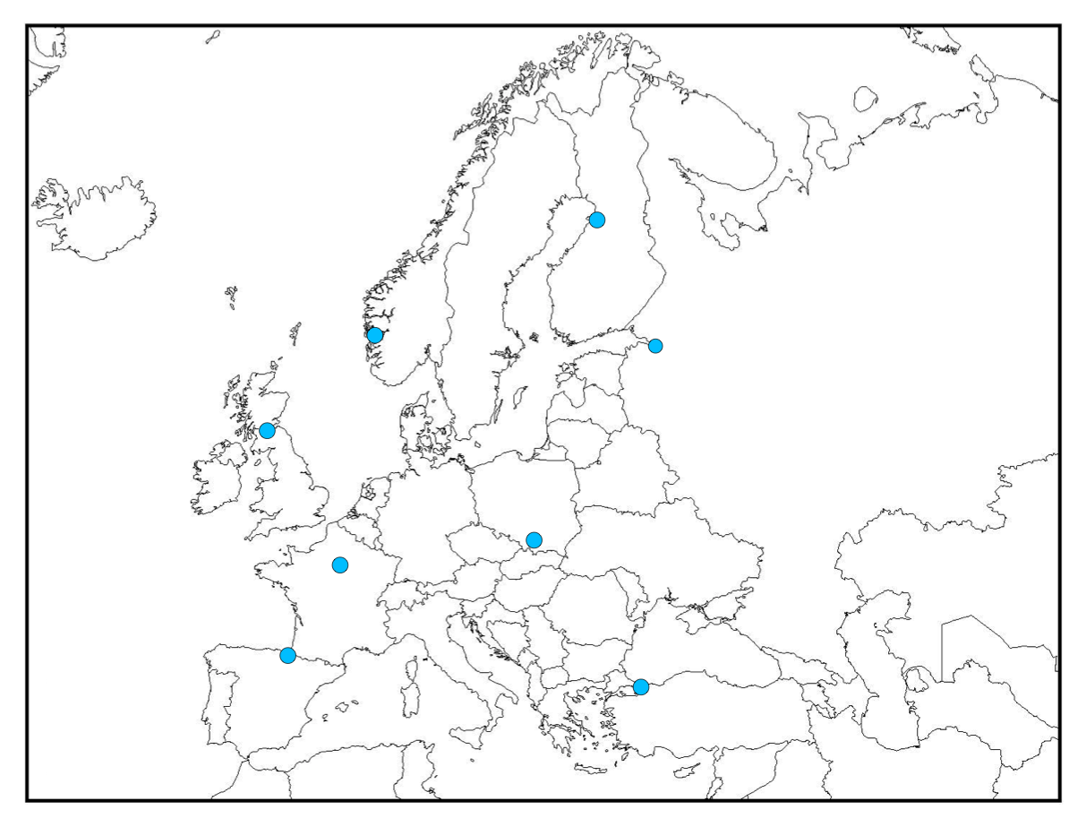

Elementary Landscape Decomposition The quadratic assignment problem (QAP)
Elementary landscape decomposition
The quadratic assignment problem (QAP)
8
1
7
2
6
3
2
4
5
5
6
3
7
1
8
4

Slide 107
Elementary Landscape Decomposition The quadratic assignment problem (QAP)
Elementary landscape decomposition
The quadratic assignment problem (QAP)
8
1
7
2
6
3
2
4
5
5
6
3
7
1
8
4

Slide 108
Elementary landscape decomposition 2-objective QAP
According to Chicano et al. 2010
QAP
Generalized QAP

Slide 109
Elementary landscape decomposition 2-objective QAP
According to Chicano et al. 2010
Generalized QAP
Under the interchange neighborhood
Landscape 1
Landscape 2
Landscape 3

Slide 110
Elementary landscape decomposition 2-objective QAP
Landscape 1
Landscape 2
Landscape 3
In the classic QAP the matrix is symmetric, as a result
2-objective QAP

Slide 111
Experiments
Adapted NSGA-II for the 2-objective QAP
SGA for the classical QAP
108 instances: 35 random, 73 real-life like
Instances |  | NSGA-II | SGA
Random | 35 | 24 | 11
Real-life like | 73 | 70 | 3
Total | 108 | 94 | 14
%68
%95

Slide 112
Conclusions
A general multi-objectivization strategy based on the elementary landscape decomposition was proposed.
Based on the decomposition of the QAP under the interchange neighborhood, we reformulated it as a 2-objective problem.
Results confirmed that solving the 2-objective QAP formulation is preferred.
Specially interesting for the real-life like instances.

Slide 113
Conclusions and Future Work

Slide 114
Conclusions
A new set of EDAs that codify probability models on the domain of permutations has been introduced.
K-order marginals-based models.
The Plackett-Luce model
The Mallows and Generalized Mallows models.
Kendall
Cayley
Ulam
The linear ordering problem has been studied and an efficient insert neighborhood system that outperforms existing approaches has been proposed.
A general multi-objectivization strategy based on the elementary landscape decomposition has been proposed and applied to solve the quadratic assignment problem.

Slide 115
Future Work Part I
Investigate mixtures or kernels of Generalized Mallows models to approach multimodal spaces.
Study the convergence of the Mallows and Generalized Mallows EDAs to local optima of the implemented distances.
Analyze the suitability of the proposed models to solve a given problem by calculating the Kullback-Leibler divergence with respect to the Boltzmann distribution associated to the problem.
Include other distances such as Hamming or Spearman.

Slide 116
Future Work Part II
Investigate multivariate information associated to the items.
Study further applications of the restrictions matrix.
Branch and bound algorithms.

Slide 117
Future Work Part III
Extend the elementary landscape decomposition to the LOP and TSP.
Particular cases of the Generalized QAP.
Find an orthogonal basis of functions to decompose the landscape produced by the insert neighborhood under the LOP.
Study the shape of elementary landscapes of the decomposition in relation to the values of the QAP instances.

Slide 118



Publications Articles
J. Ceberio, E. Irurozki, A. Mendiburu & J.A. Lozano (2012). A review on Estimation of Distribution Algorithms in Permutation-based Combinatorial Optimization Problems. Progress in Artificial Intelligence. Vol 1, No. 1, Pp. 103-117. Citations in Google scholar : 30.
J. Ceberio, E. Irurozki, A. Mendiburu & J.A. Lozano (2014). A Distance-based Ranking Model Estimation of Distribution Algorithm for the Flowshop Scheduling Problem. IEEE Transactions on Evolutionary Computation. Vol 18, No. 2, Pp. 286-300.
J. Ceberio, A. Mendiburu, J.A. Lozano (2015). The Linear Ordering Problem Revisited. European Journal of Operational Research. Vol 241, No. 3, Pp. 686-696.

Slide 119


Publications Articles
J. Ceberio, E. Irurozki, A. Mendiburu & J.A. Lozano (2014). A Review of Distances for the Mallows and Generalized Mallows Estimation of Distribution Algorithms. Journal of Computational Optimization and Applications. Submitted.
J. Ceberio, A. Mendiburu & J.A. Lozano (2014). Multi-objectivizing the Quadratic Assignment Problem by means of a Elementary Landscape Decomposition. Natural Computing. Submitted.

Slide 120
Publications Conference Communications
J. Ceberio, A. Mendiburu & J.A. Lozano (2011). A Preliminary Study on EDAs for Permutation Problems Based on Marginal-based Models. In Proceedings of the 2011 Genetic and Evolutionary Computation Conference, Dublin, Ireland, 12-16 July.
J. Ceberio, A. Mendiburu & J.A. Lozano (2011). Introducing the Mallows Model on Estimation of Distribution Algorithms. In Proceedings of the 2011 International Conference on Neural Information Processing, Shanghai, China, 23-25 November. Pp. 461-470.
J. Ceberio, A. Mendiburu & J.A. Lozano (2013). The Plackett-Luce Ranking Model on Permutation-based Optimization Problems. . In Proceedings of the 2013 IEEE Congress on Evolutionary Computation, Cancun, Mexico, 20-23 June.
J. Ceberio, L. Hernando, A. Mendiburu & J.A. Lozano (2013). Understanding Instance Complexity in the Linear Ordering Problem. In Proceedings of the 2013 International Conference on Intelligent Data Engineering and Automated Learning, Hefei, Anhui, China, 20-23 October.
J. Ceberio, E. Irurozki, A. Mendiburu & J.A. Lozano (2014). Extending Distance-based Ranking Models in Estimation of Distribution Algorithms. In Proceedings of the 2014 IEEE Congress on Evolutionary Computation, Beijing, China, 6-11 July.

Slide 121
Publications Collaborations
E. Irurozki, J. Ceberio, B. Calvo & J. A. Lozano. (2014). Mallows model under the Ulam distance: a feasible combinatorial approach. Neural Information Processing Systems (NIPS) – Workshop of Analysis of Rank Data.

Slide 122
Solving Permutation Problems with Estimation of Distribution Algorithms and Extensions Thereof
Josu Ceberio

